Slide 1
Warm Up
What would happen if you are driving a car 40 miles per hour forward, and you throw a baseball out the back at 40 miles per hour?

Slide 2
Vectors!

Slide 3
Vectors!

Slide 4
Mass (m) vs. Weight (F_{g})
The amount of “stuff” or “matter” in an object
Units: kilogram (kg)

Slide 5
Mass vs. Weight (F_{g})
The measurement of how hard gravity pulls on an object.
F_{g} = mg g=9.8 m/s²
Weight is a force!!!
Units: pounds (lbs) or Newton (N)
Weight changes when gravity changes

Slide 6
Force
Any push or pull on an object
What examples of force do you know?
List 3 examples.
GRAVITY
We ALWAYS have the force of gravity acting on us
(unless we are not on earth)

Slide 7
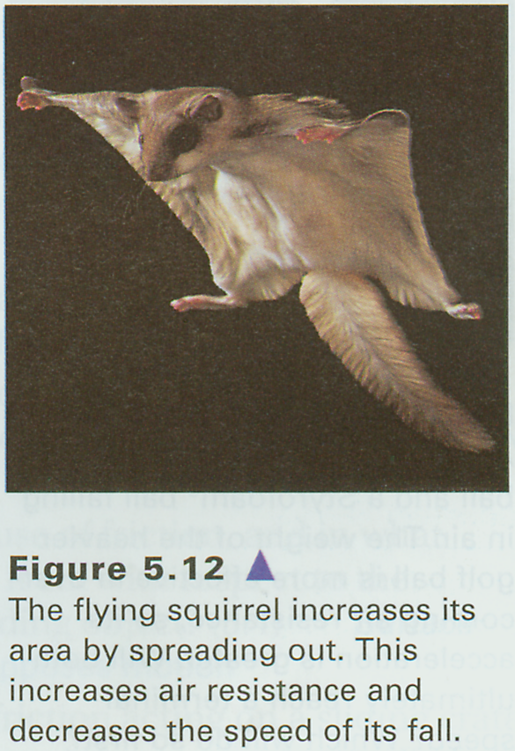
Why doesn’t everything fall at the same rate?
Air Resistance!
If they balance out the weight of the object this is called Terminal Velocity

Slide 8
Terminal velocity
When the force of weight cancels out with the air resistance.
Net Force is zero
You move at a constant speed
Net Force
A combination of all the forces on an object
If you push equally on both sides then the forces cancel out and there is a net force of ZERO

Slide 10
Static vs. Dynamic

Slide 11
Free Body Diagrams
A picture of all the forces acting on an object
The object will always be drawn as a dot and the forces come from the dot.
F_{NET} =
F_{N} = normal force
-the force from a surface

Slide 12
Combining Net Force
F_{NET} =

Slide 13
Combining Net Force
F_{N}
F_{N}
F_{NET} = F_{N} + F_{N} – F_{w}
F_{w}

Slide 14
Free Body Diagrams
A picture of all the forces acting on an object
The object will always be drawn as a dot and the forces come from the dot.
F_{N}
F_{NET} = F_{N} – F_{G}
F_{N} = normal force
-the force from a surface
F_{G}

