Slide 1
Warm Up
How many minutes are in a month?
How many toes are in this classroom?

Slide 2
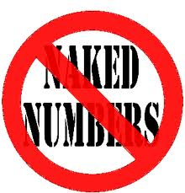
Units of Measurement
1 meter
unit
quantity
All scientific measurements always have both a quantity and a unit
No NAKED NUMBERS!

Slide 3
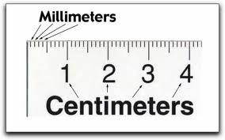
Units for Length:
A 5k running race is 5 kilometers
or the same thing as 3.1 miles
1 Kilometer (km) = 1000 meters
Bigger than 1 meter
1 Meter (m) - approximately 1 leg length
Smaller than 1 meter
100 Centimeter (cm) =1 meter
1000 Millimeter (mm)=1 meter

Slide 4
Metric Conversions
King Henry Doesn’t Usually Drink Chocolate Milk

